Slide 1

2025-26
Laws of the Game

Slide 2


Laws of the Game 2025-26
LAW I
Competition Format and Elo

Slide 3
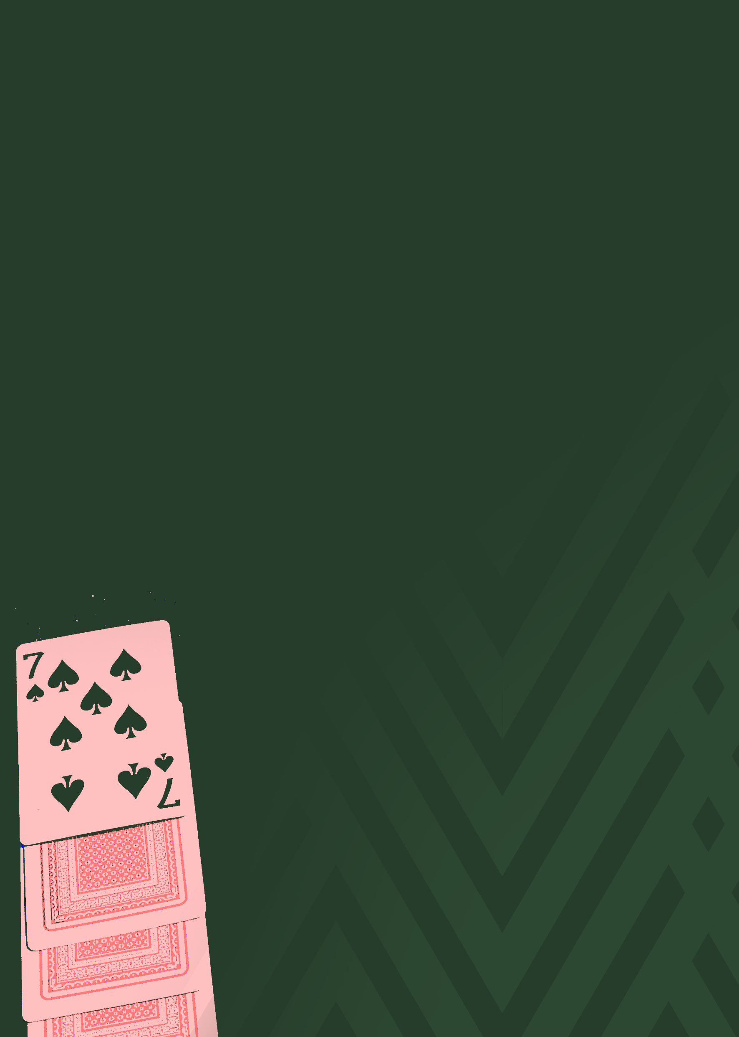

The philosophy and spirit
of the Laws
SLAPS is a fast-paced competitive card game played in living rooms, community halls, student flats, workplaces, and tournament venues across the world. Its accessibility, minimal equipment requirements, and emphasis on reflex, precision and fairness have allowed it to grow organically in many regions, with new players learning the game every day.
One of the game’s greatest strengths is that the Laws of SLAPS remain the same wherever it is played — from an officially sanctioned championship final to a casual game between friends on a kitchen table. This universality is vital to the integrity and future development of SLAPS.
SLAPS must have Laws which keep the game fair. This is a fundamental principle of competitive play and a core element of the “spirit” of the game. The most enjoyable and respected matches are those in which the referee is seldom required to intervene because the players conduct themselves with respect for each other, for the officials and for the Laws.
The Laws of SLAPS are clear and structured, yet many situations depend on quick judgement, and match officials are human. Referee decisions will sometimes be debated, questioned or disagreed with. For many players, this discussion is part of the game’s enjoyment and identity. However, regardless of whether decisions are correct, uncertain or contentious, the spirit of SLAPS requires that all participants respect the referee’s final decision. Those in positions of influence have a particular responsibility to uphold this principle and ensure that the referee’s authority is maintained throughout the match.
Laws of the Game 2025-26
About the Laws

Slide 4
As with all competitive activities, the Laws cannot cover every conceivable situation. Where an unusual circumstance arises, and the Laws provide no direct answer, the referee is expected to make a decision guided by the established “spirit of SLAPS” and the intention behind the Laws. This often involves asking the question: “What outcome maintains fairness, flow, and the integrity of SLAPS?”
Concerns about participant behaviour continue to grow as the game expands. It is essential that all players, spectators and officials treat each other with respect in order to protect the atmosphere of competition and ensure that SLAPS remains enjoyable for everyone. To help encourage this, some competitions may implement policies limiting which players may approach the referee after significant incidents or decisions. There is strong evidence that restricting direct interaction to designated players improves communication, reduces confrontation, and enhances the overall conduct and image of the match. This approach is particularly important for the long-term recruitment and retention of referees.
As SLAPS evolves, trials are occasionally conducted to test potential improvements to the game’s Laws or officiating procedures. Where appropriate, competitions may adopt or trial enhancements such as clearer referee signals, structured restart protocols, or additional disciplinary tools designed to keep the game flowing efficiently. These measures aim to improve fairness, transparency and the playing experience without compromising the spirit of SLAPS.
The Laws must also protect the welfare of participants. While SLAPS is a non-contact game, accidents or unsafe behaviour can still occur. The Laws therefore require referees to act firmly against any conduct that is dangerous, reckless, intentionally disruptive, or threatens the safety or enjoyment of others. Disciplinary language in the Laws — such as “unsporting behaviour”, “reckless action” or “excessive force” — reflects an uncompromising stance against actions that endanger opponents or undermine the integrity of the game.
To promote wider understanding of SLAPS, simplified versions of the Laws may be produced for new players, developing officials, or those learning the game for the first time. These summaries explain the essential concepts in accessible language and introduce competitive play. They are designed to support players, referees, spectators and organisers in gaining a clearer understanding of how SLAPS is meant to be played.
Audio versions, simplified guides and visual explanations may also be developed to support accessibility and worldwide learning as SLAPS continues to grow.
For more information, please email internationalslapsfederation@gmail.com
Laws of the Game 2025-26
About the Laws

Slide 5

Slaps – Slim Edition Beginners Guide
A simple checklist for setup, core rules, and how to win.
1. How to Set Up
Two players only.
Use one standard 52-card deck with no jokers
Shuffle the deck and deal half to each player 26 cards each
Each player places their cards face-down as their personal deck.
Build your Foundation Pile using the top 10 cards:
4-card pile
3-card pile
2-card pile
1-card pile
Top card of each pile is turned face-up (max 4 live cards).
Remaining cards become your Draw Deck, placed face-down.
Place both players’ Draw Decks on the central mat, above each Centre Pile.
Two Centre Piles exist in the middle: left and right (both start empty).
A referee should be present for official play.
2. How a Game Starts
Both players agree on the count (“1-2-3”, “3-2-1”, or “go”).
On the final count, both players reveal the top card of their Draw Deck at the same time onto opposite Centre Piles.
Normal play begins immediately.
Laws of the Game 2025-26
Slaps – Slim Edition
Beginners Guide

Slide 6
3. Key Rules of Play
Foundation Cards
You may only play live cards (top face-up cards).
Max four live cards at any time.
You may move or reorganise cards within your foundation zone.
Legal Plays
You can play a card onto either Centre Pile.
A card is legal if it is one rank higher or one rank lower than the top card of that Centre Pile.
Sequence loops:
A → 2 → 3 → … → Q → K → A
Only one card at a time may leave your foundation.
Illegal Plays
Having 2 cards out of the foundation pile boundary at once.
Playing a card out of sequence is illegal.
If removed instantly → warning.
If left on pile → penalty.
Reveals
You may not touch your Draw Deck except during a Reveal.
Reveals must not expose the card early.
Stalemate
If neither player has a legal play:
Both reveal a new card simultaneously.
Draw Deck Shortage
If a player’s Draw Deck reaches zero, play continues until a stoppage.
When a stoppage occurs, the opponent’s Draw Deck is split in half, and the top half is loaned to the shorted player.
Borrowed cards function normally but still “belong” to their owner.
4. Slap Challenges - Key Points
A slap is triggered when both Centre Piles show the same rank.
To win the slap, you must place:
one hand on the left pile
one hand on the right pile
First player with both hands down wins the slap.
The loser takes all Centre Pile cards into a slap penalty pile.
These penalty cards are dead for the rest of the game and are added to your deck for the next game.
If the final Foundation card creates a matching rank → no slap; game ends immediately.
5. How a Game Ends
A game ends the moment a player plays their final Foundation card legally.
Slaps cannot occur after the final card.
Winner is first to clear their Foundation Pile.
Players collect their own cards, shuffle, rebuild Foundations, and begin the next game.
6. How to Win the Match
A player wins the match only when they have eliminated:
All Foundation cards
All Draw Deck cards including borrowed ones
All slap penalty cards
A match can take multiple games to complete
Laws of the Game 2025-26
Slaps – Slim Edition
Beginners Guide

Slide 7
General Provisions
A.1 Purpose of the Laws
A.1.1 The Laws of SLAPS exist to ensure that all matches are conducted in a fair, consistent and orderly manner.
A.1.2 The Laws provide a clear framework for gameplay, officiating, discipline and match structure.
A.1.3 The Laws apply equally to all levels of play, including casual matches, competitive tournaments and officially sanctioned events.
A.1.4 The Laws aim to preserve the integrity, flow and reflex-based nature of SLAPS while maintaining a balance between skill, anticipation, luck and fairness.
A.1.5 The Laws are designed so that SLAPS can be played anywhere, by anyone, using the same standards worldwide.
A.2 Scope of Application
A.2.1 The Laws of SLAPS govern all aspects of play, including equipment, player conduct, gameplay mechanics, restarts, slaps, stalemates, draw deck procedures and match completion.
A.2.2 These Laws apply to all matches unless a recognised competition authority issues additional regulations consistent with the Laws.
A.2.3 Matches without an appointed referee are classified as friendly.
A.2.4 Official competition matches cannot commence or continue without a referee.
A.2.5 Friendly matches do not contribute to official records or competition standings.
A.3 Authority of Referees
A.3.1 A match is controlled by a referee who has full authority to enforce the Laws of SLAPS.
A.3.2 The referee’s decisions regarding facts connected with play, including slaps, timing, boundary violations, card placement, stalemates and draw deck procedures, are final.
Law
A
Laws of the Game 2025-26
LAW A
General Provisions

Slide 8
A.3.3 The referee may consult assistant officials or video review, where available, but is not obliged to do so.
A.3.3.1 Assistant referees may be used to provide additional information during a match but are not required. The referee’s decision takes precedence in all cases.
A.3.4 The referee may stop, suspend or terminate a match if:
A.3.4.1 external interference occurs.
A.3.4.2 equipment becomes unsafe or unfit;
A.3.4.3 a player’s conduct makes continuation impossible;
A.3.4.4 any situation arises that prevents fair play.
A.3.5 Participants must respect the referee’s authority at all times.
A.3.6 Players may request clarification of a referee’s decision only when gameplay is not ongoing and only when done respectfully.
A.3.7 No player may challenge the authority of the referee or dispute the referee’s final decision.
A.4 Definitions - Key Terms
This is a legal definitions section—not a glossary. Only essential rule-terminology appears here.
A.4.1 “Foundation Pile” – The structured arrangement of ten cards (4–3–2–1) from which players play live cards.
A.4.2 “Live Card” – The uppermost face-up card of any part of the Foundation Pile that is legally playable.
A.4.3 “Boundary” – The marked line on the mat indicating the limit beyond which only one legally playable card may be present.
A.4.4 “Draw Deck” – A player’s reserve pile of face-down cards used for stalemate reveals and initial setup.
A.4.5 “Centre Piles” – The two piles of shared play where cards are placed in sequence.
A.4.6 “Slap” – A reflex challenge triggered when both Centre Piles display cards of the same rank.
A.4.7 “Stalemate” – A state in which no legal moves exist for either player, requiring a Draw Deck reveal restart.
A.4.8 “Match” – A series of one or more Games played until one player has no cards remaining under their control.
A.4.9 “Game” – A single instance of play ending when one player clears their Foundation Pile.
A.4.10 “Card Ownership” – The status of which cards belong to a player for the duration of the match, including borrowed or acquired cards.
A.4.11 “Card reveal” – The action of flipping the top card on each draw deck pile onto the centre pile.
A.5 Overriding Principles
A.5.1 The Laws must be interpreted in accordance with the spirit and intention of SLAPS.
A.5.2 Players must not exploit loopholes or unusual situations to gain unfair advantage.
A.5.3 Where the Laws do not explicitly cover a situation, referees must make a decision based on fairness, flow, and established competitive standards.
A.6 Spirit of the Game
A.6.1 SLAPS is built on reflex, accuracy, fairness, respect and the simultaneous nature of play.
A.6.2 Players are expected to act with honesty, integrity and sportsmanship at all times.
A.6.3 Excessive confrontation, deliberate disruption or attempts to manipulate restarts undermine the game and may result in disciplinary action.
A.6.4 Participants must respect the opposition, officials, equipment and the Laws.
A.6.5 The goal of the Spirit of the Game is to safeguard enjoyment, ensure fairness and maintain the tempo and character of SLAPS.
Laws of the Game 2025-26
Slaps – Slim Edition
Beginners Guide

Slide 9
The Playing Area and Equipment
B.1 The Playing Surface
B.1.1 SLAPS may be played on any stable table that is large enough to accommodate the three official mats fully and securely.
B.1.2 Where official mats are available, they must be used for all competitive matches.
B.1.3 Where mats are not available, the referee must define the playing boundaries clearly prior to the match; once approved by both players, the match is considered valid for competition.
B.1.4 The table must be stable, free of obstructions, and at a height allowing both players to reach the Centre Pile comfortably.
B.1.5 The playing surface must remain clear throughout the match; objects that interfere with card movement or player access are not permitted.
B.2 Official Mats and Boundaries
B.2.1 The official Slaps setup consists of three mats:
B.2.1.1 Player 1 Foundation Mat
B.2.1.2 Player 2 Foundation Mat
B.2.1.3 Central Mat (Centre Piles with Draw Deck boundaries)
B.2.2 Foundation Mats measure approximately 80 × 30 cm; these dimensions are non-binding but provide consistent spacing in competitive play.
B.2.3 The boundaries of all mat zones must be clearly visible, with sufficient space for four live cards and the natural movement caused by fast-paced play.
B.2.4 Minor movement of cards beyond boundaries caused by speed or impact is not a violation.
B.2.5 The referee may instruct a player to reposition a displaced card if necessary, without penalising the player or interrupting play unless fairness requires it.
Law
B
Laws of the Game 2025-26
LAW B
The Playing Area and Equipment

Slide 10
B.2.6 Foundation Mat boundaries are fixed and must not be altered during a match.
B.3 Foundation Pile Zones
B.3.1 Each Foundation Mat contains a marked zone indicating where the player must arrange their Foundation Pile (4–3–2–1 formation).
B.3.2 The zone must be large enough to contain all four sub-piles without cards spilling outside during natural gameplay.
B.3.3 Players may arrange, rotate, angle, or overlap cards within the zone as they wish, provided no more than four live cards exist at any time.
B.3.4 The orientation of the Foundation Pile zone is fixed and identical for both players.
B.4 Central Mat and Centre Piles
B.4.1 The Central Mat contains:
B.4.1.1 A zone for Player 1’s Draw Deck
B.4.1.2 A zone for Player 2’s Draw Deck
B.4.1.3 A large central zone for the two Centre Piles
B.4.2 The Centre Pile zone must be large enough to hold multiple cards as the piles grow and to accommodate natural displacement during slaps.
B.4.3 The dividing line indicating the two separate Centre Piles may be represented by a thin mark; this line is non-restrictive and used for initial placement only.
B.4.4 Cards that move outside the Centre Pile zone due to impact remain valid unless they interfere with access or visibility. The referee may instruct repositioning if required.
B.5 Draw Deck Placement
B.5.1 Each player’s Draw Deck must be placed face-down entirely within the marked Draw Deck zone.
B.5.2 Players must not hold, touch, or interfere with their Draw Deck except when required to reveal a card during a restart or at the referee’s instruction.
B.5.3 If the Draw Deck is accidentally displaced and no cards are revealed, the deck must be returned to its zone without penalty.
B.5.4 If cards become exposed accidentally, the referee must determine whether play continues or whether a stoppage is required to restore fairness.
B.6 Card Standards and Replacement
B.6.1 All matches must use a standard 52-card deck with no jokers.
B.6.2 Any brand or design may be used, provided the cards are of uniform size and standard playing card material.
B.6.3 Cards must be untampered, unmarked, and free of identifiable defects prior to the match.
B.6.4 Sleeved, coated, or plastic-sealed cards are not permitted.
B.6.5 If any card becomes recognisable from damage, wear, or shape, the referee must replace the entire deck at the end of the current game.
B.6.6 Deck replacement procedure:
B.6.6.1 The referee counts how many cards each player currently owns.
B.6.6.2 A new deck is shuffled thoroughly.
B.6.6.3 Each player receives the same number of cards as before.
B.6.6.4 The game or match continues normally.
B.6.7 Replacement deck brand need not match the original.
B.6.8 The referee has full discretion to replace a deck if fairness is compromised.
B.7 Accessories and Additional Equipment
B.7.1 Players may wear accessories provided they do not provide a competitive advantage or impede fair play.
B.7.2 Substances or materials that alter grip, friction, or card movement e.g., chalk, rosin, adhesives) are prohibited.
B.7.3 Mats should ideally be green but colour is not regulated.
B.7.4 Mats must be made from a stable, non-slip material underneath with a smooth, free-moving surface on top to allow natural card motion.
B.7.5 Barriers, edges, or table modifications that restrict card movement or alter gameplay dynamics are prohibited unless specifically approved by the referee.
Laws of the Game 2025-26
LAW B
The Playing Area and Equipment

Slide 11
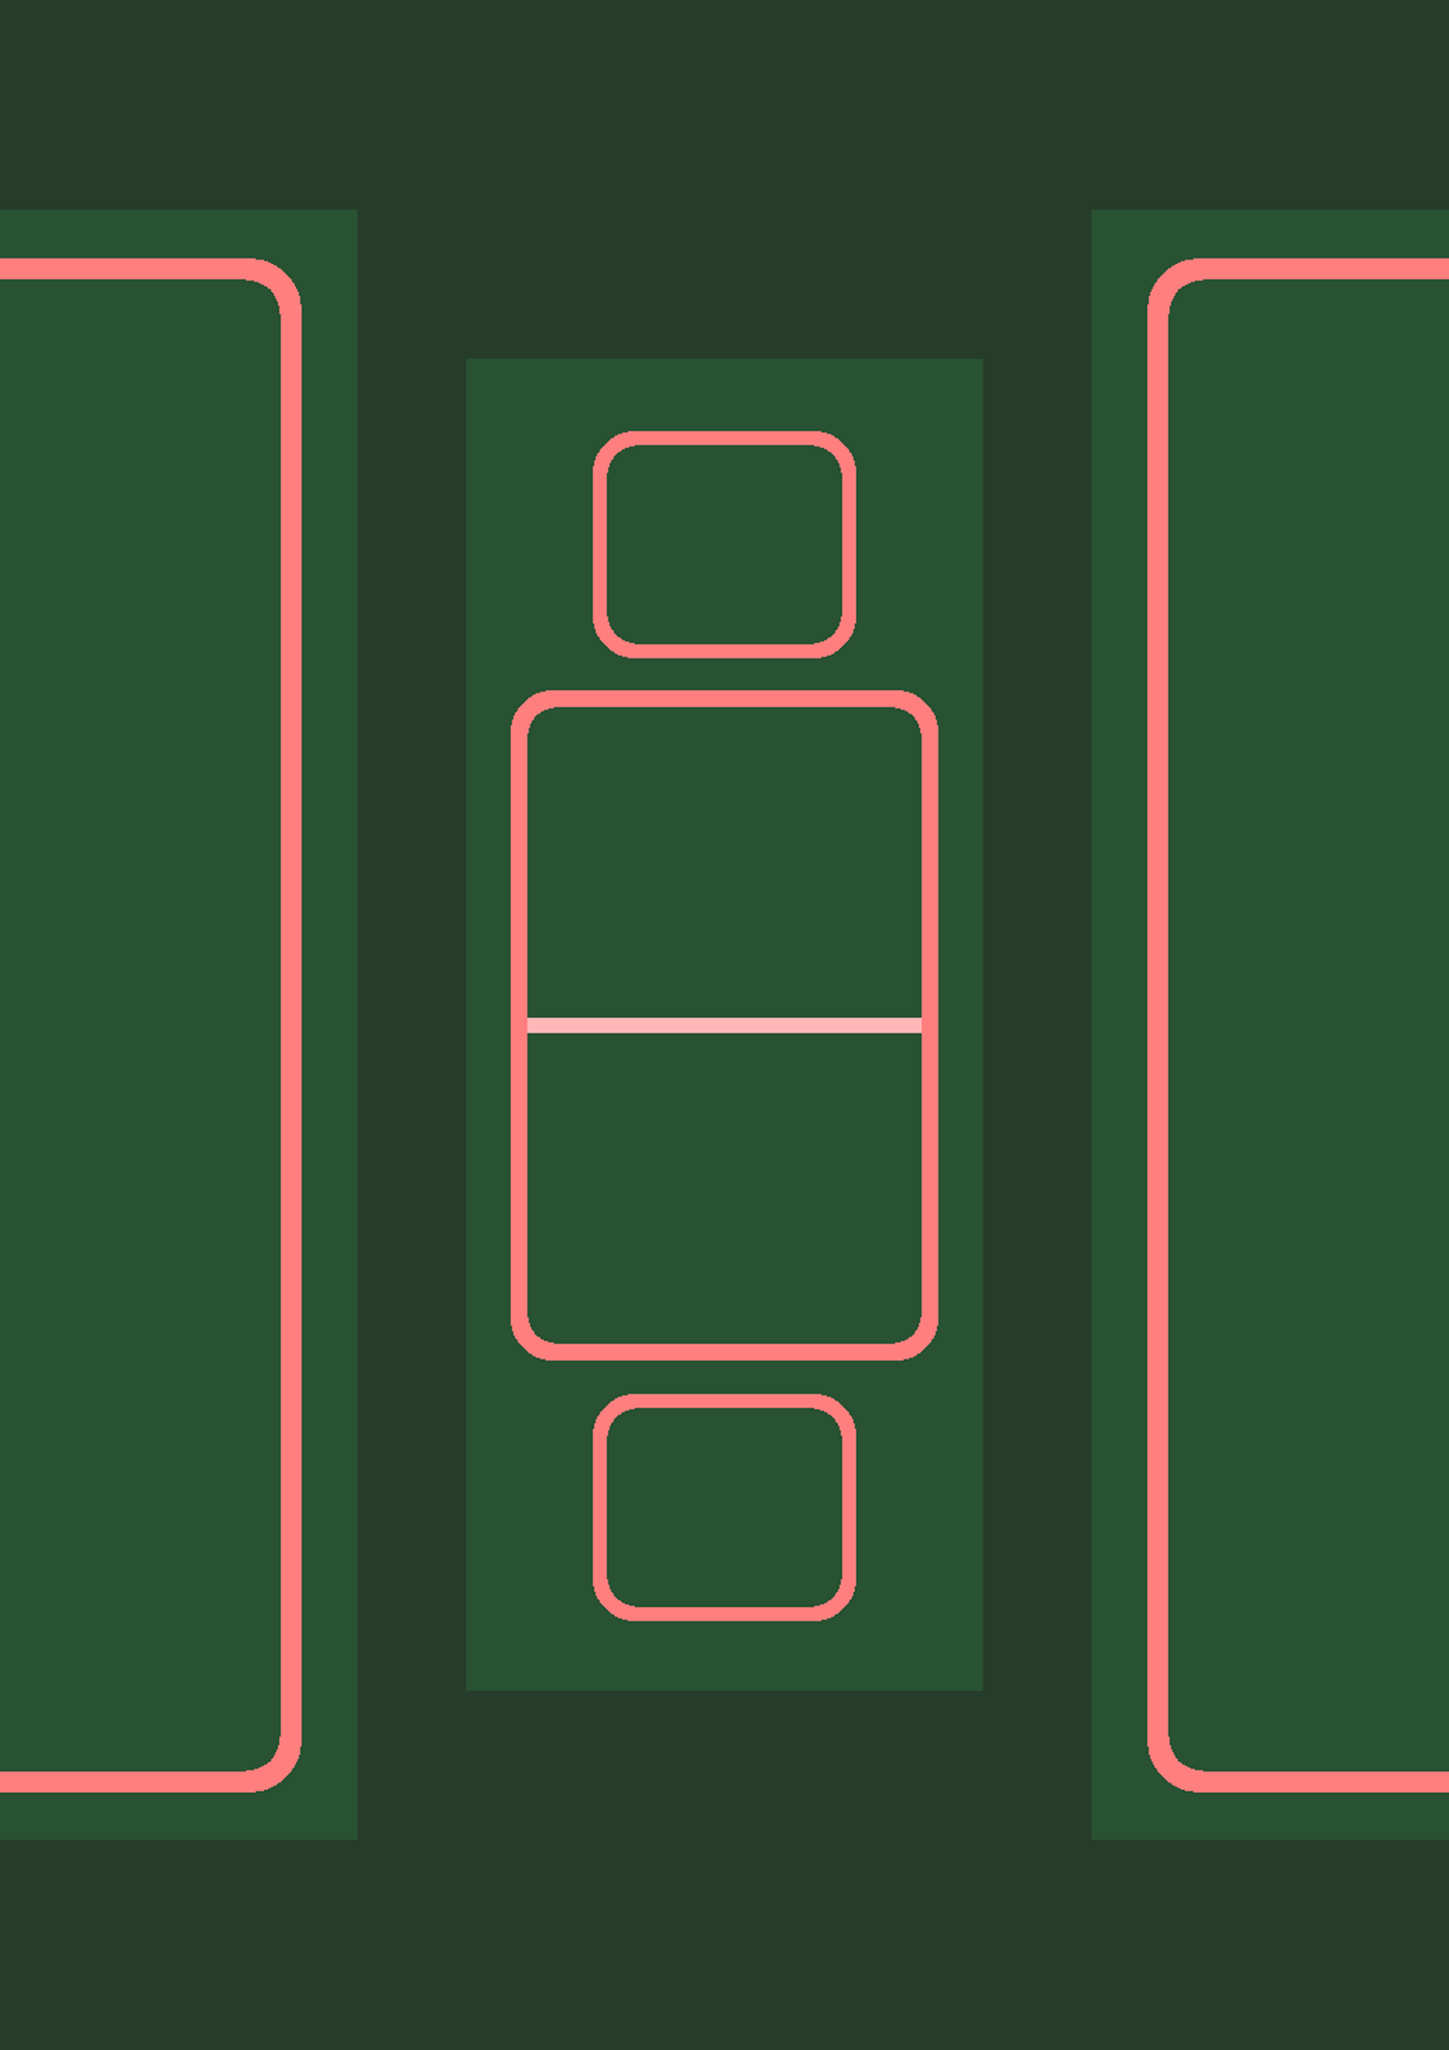
Playing Area
Player 1 Foundation Pile Mat
Playing Area Diagram
≈30cm
Exact measurements are not mandatory. Provided that a clear and agreed boundary exists, and that the game can be played without hindrance to either player, any suitably proportioned layout is permitted.
1. General Principles
The Playing Area must be clearly defined before play begins.
All boundaries must be visible and understood by both players.
The layout must allow fair access to all piles and decks.
No player may be disadvantaged by spacing, reach, or obstruction.
The diagram measurements are indicative only and exist as a guide to scale and proportion.
2. Layout Structure
The Playing Area is typically arranged into three vertical zones:
Player 1 Area
Central Playing Area
Player 2 Area
This arrangement is recommended but not compulsory, provided the functional requirements of play are met.
3. Foundation Areas
Each player must have a designated Foundation Area.
A Foundation Area must contain a clearly defined Foundation Pile Boundary.
A separate physical mat is not required.
Boundaries may be marked directly on a single shared mat or surface.
Reference dimensions shown in the diagram are approximately:
Foundation Pile Mat height: 30 cm
Foundation Pile Boundary width: 25 cm
Foundation Areas for both players should be broadly equivalent in size and orientation.
≈25cm
Center Pile Mat
Player 1 Foundation Pile Boundary
≈28cm
≈15cm
Player 2 Draw Deck Boundary
≈12cm
≈21cm
Player 2 Center Pile
Boundary
≈72cm
≈72cm
≈80cm
≈33cm
≈80cm
≈66cm
Player 1 Center Pile
Boundary
≈12cm
Player 1 Draw Deck Boundary
≈15cm
Player 2 Foundation Pile Boundary
≈25cm
≈30cm
Player 2 Foundation Pile Mat
Laws of the Game 2025-26
LAW B
The Playing Area and Equipment

Slide 12
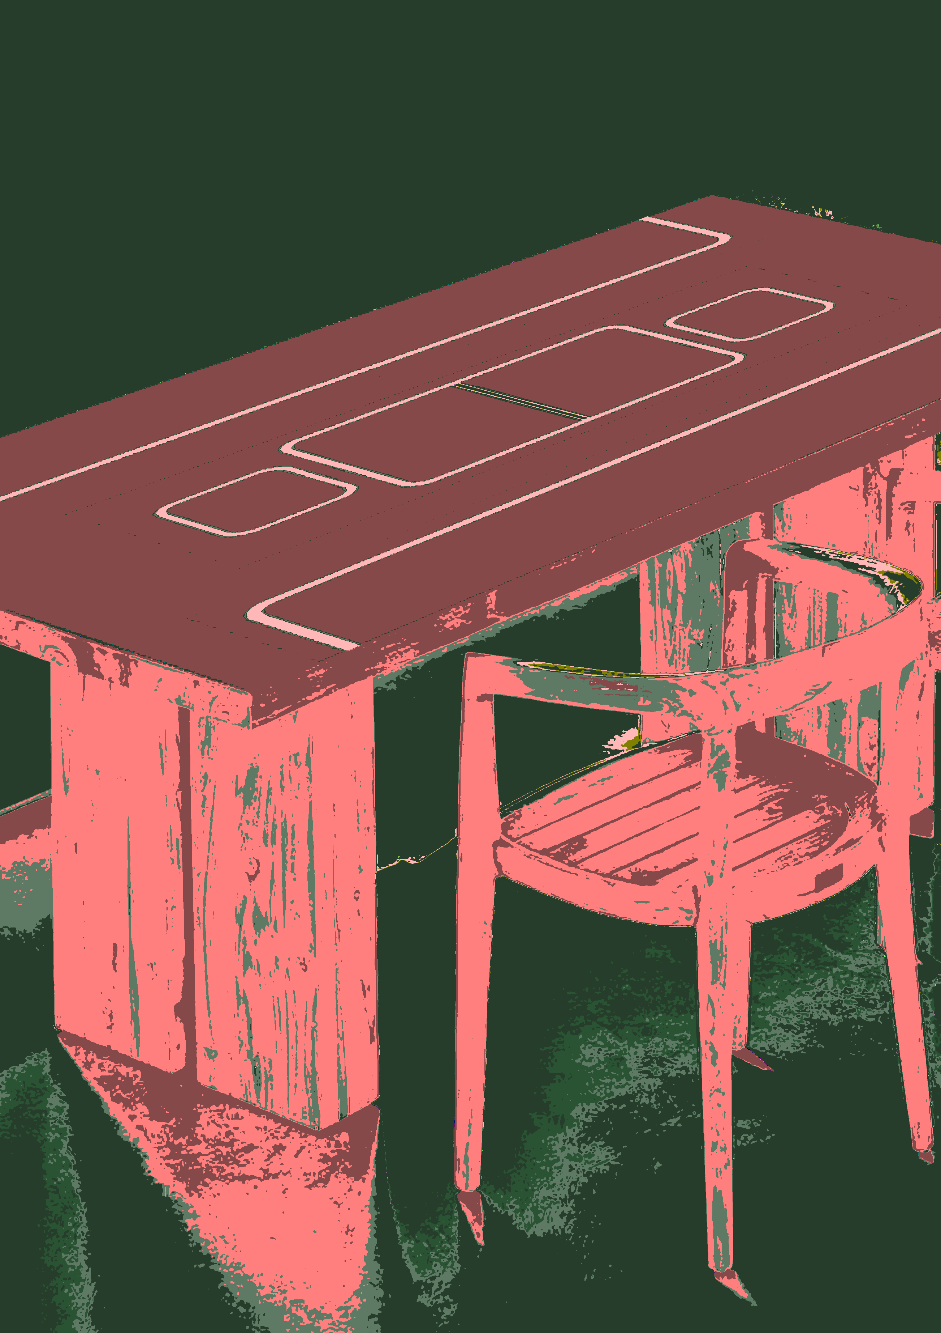
4. Central Playing Area
The Central Playing Area contains the active piles used during play.
This area may be marked using a single continuous surface and does not require multiple separate mats.
The following elements are recommended:
a) Centre Pile Area
A defined central boundary for active play
Approximate reference width: 21 cm
Horizontally divided to distinguish Player 2 and Player 1 Centre Piles
b) Centre Pile Mat
Positioned above the Centre Pile Area
Approximate reference width: 28 cm
5. Draw Deck Areas
Each player must have a designated Draw Deck Area.
These areas must be clearly separated from the Centre Pile Area.
Separate mats are optional.
Boundaries may be marked directly on the playing surface.
Reference dimensions shown in the diagram are approximately:
Width: 15 cm
Height: 12 cm
6. Boundary Requirements
All boundaries must be clearly defined.
Boundary width, colour, and shape may vary.
Boundaries must not overlap in a way that causes ambiguity.
Any configuration that creates confusion, obstructs play, or interferes with slap resolution is not permitted.
7. Compliance
Provided the Playing Area meets the principles above, variations in size, proportion, and layout are allowed.
The overriding requirement is that the game of Slaps can be played fairly, clearly, and without physical interference between players.
Laws of the Game 2025-26
LAW B
The Playing Area and Equipment

Slide 13
Players and Officials
C.1 The Players
C.1.1 A match of SLAPS is played between two players only.
C.1.2 Any modification to this format, including team play or rotational play, is not recognised as official and cannot be sanctioned.
C.1.3 Both players have an equal status within the match; no player holds any special role or privilege.
C.1.4 Players must:
C.1.4.1 follow all Laws of SLAPS;
C.1.4.2 attempt to win the match within the Laws;
C.1.4.3 maintain the integrity and tempo of the game;
C.1.4.4 avoid behaviour that disrupts, delays or manipulates play.
C.1.5 Players may agree upon who counts the opening sequence (“1-2-3” or “3-2-1”) and whether the final command is “on 1,” “on 3,” or “on go,” prior to the start of each game.
C.1.6 Both players may participate in the count, one player may count, or the referee may count if both players agree.
C.2 Player Conduct During Play
C.2.1 Players may rest their hands on the table provided this does not obstruct the opponent or gain unfair advantage.
C.2.2 Players must not lean forward aggressively, deliberately intimidate, or interfere physically or verbally with an opponent.
C.2.3 Natural body movements during fast-paced play are permitted, but players must avoid obstructive or unsafe positioning.
C.2.4 Players must not make contact with an opponent except through normal incidental motion.
C.2.5 Swapping sides of the table during a match is not permitted.
C.2.6 Players may request that the Centre Pile be neatened during a stoppage, at the referee’s discretion.
Law
C
Laws of the Game 2025-26
LAW C
Players and Officials

Slide 14
C.3 Communication
C.3.1 Players may speak during play provided the communication is non-aggressive, non-offensive and does not disrupt the match.
C.3.2 Players may discuss rules or clarifications with each other unless the referee determines such discussion to be disruptive or manipulative.
C.3.3 Players may request clarification from the referee only during a stoppage in play.
C.3.4 No timeouts or pauses may be requested by players during competitive matches.
C.4 The Referee
C.4.1 Every official match must be controlled by a referee with full authority to enforce the Laws of SLAPS.
C.4.2 The referee ensures both players are ready before starting the match.
C.4.3 The referee enforces all Laws, makes decisions in close or ambiguous situations, and ensures fairness throughout the match.
C.4.4 The referee is responsible for keeping the official score, including:
C.4.4.1 games won;
C.4.4.2 slaps won;
C.4.4.3 any cards shown.
C.4.5 The referee may:
C.4.5.1 stop, suspend or terminate the match;
C.4.5.2 overrule a player’s call;
C.4.5.3 declare a stalemate;
C.4.5.4 determine whether a slap was valid or “too close to call”;
C.4.5.5 reposition cards if necessary to maintain clarity and fairness;
C.4.5.6 order deck replacement;
C.4.5.7 issue disciplinary sanctions.
C.4.6 The referee may use video review in competitions where it is available, entirely at their discretion.
C.5 Assistant Referees
C.5.1 Assistant referees are not required and are generally unnecessary for standard matches.
C.5.2 Assistant referees may be used in high-stakes matches, such as finals, where additional observation may assist the referee.
C.5.3 Assistant referees do not make decisions; they provide information only when requested.
C.5.4 The referee’s decision takes precedence over any input from an assistant referee.
C.5.5 The referee may choose whether assistant referees are permitted to review video footage, where available.
Laws of the Game 2025-26
LAW C
Players and Officials

Slide 15
Card Play Mechanics
D.1 Overview
D.1.1 This Law sets out all procedures and requirements for handling, arranging, and playing cards during a match of SLAPS.
D.1.2 All mechanics defined in this Law apply to every game and every match unless otherwise stated.
D.1.3 Slap challenges are governed separately under Law F – Slap Challenges. Any reference to a potential slap before Law F must defer to that section.
D.2 Foundation Pile
D.2.1 At the start of each game, each player must construct a Foundation Pile using the top cards of their personal deck.
D.2.2 The standard Foundation layout consists of four sub-piles arranged as follows:
D.2.2.1 A pile of four cards;
D.2.2.2 A pile of three cards;
D.2.2.3 A pile of two cards;
D.2.2.4 A pile of one card.
D.2.3 Each sub-pile must have its uppermost card turned face-up.
D.2.4 If a player has fewer than ten cards available, they must construct the Foundation Pile using all available cards while respecting the maximum of four live cards (see D.3).
D.2.5 Players may position the four sub-piles in any arrangement within the Foundation boundary, provided all cards remain inside the boundary.
D.2.6 Players may reorganise or reposition sub-piles within the boundary at any time, provided gameplay is not disrupted and no Laws are violated.
D.2.7 When a live card from a sub-pile is played, another card in the foundation pile may be turned face-up at the player’s discretion.
Law
D
Laws of the Game 2025-26
LAW D
Card Play Mechanics

Slide 16
D.3 Live Cards and Boundary Restrictions
D.3.1 A maximum of four live cards may exist at any time.
D.3.2 A legally playable card may be removed from the Foundation boundary for the purpose of playing it.
D.3.3 Only one legally playable card may be outside the Foundation boundary at any moment.
D.3.4 A legally playable card may be returned to the Foundation boundary provided the player has not released it onto a Centre Pile.
D.3.5 If a player accidentally removes or displaces multiple cards from the boundary, and no unfair advantage is gained, the player must simply return the cards to the boundary without penalty.
D.3.6 A card is considered “outside the boundary” when lifted from the Foundation area.
D.4 Draw Deck Mechanics (Non-Shortage Rules)
D.4.1 All cards not used in the Foundation Pile constitute the player’s Draw Deck.
D.4.2 The Draw Deck must always remain face-down and within its designated zone.
D.4.3 A reveal must be performed in one continuous motion without delay, hesitation, or angle manipulation intended to gain unfair foreknowledge or advantage.
D.4.4 Players must not “pre-lift” the top card of the Draw Deck before a reveal.
D.4.5 If the Draw Deck is displaced without revealing cards, it must be returned to its zone without penalty.
D.4.6 Shortages, borrowing, and all special Draw Deck situations are governed under Law G – Draw Deck Shortages.
D.5 Centre Piles
D.5.1 Two Centre Piles exist in every game: left and right.
D.5.2 A legal play involves placing a live Foundation card onto either Centre Pile.
D.5.3 Cards may be placed at any angle or orientation so long as the rank on the card is visible to both players; precision is not required.
D.5.4 If a card is placed ambiguously between the two piles, and a dispute arises, the referee determines which pile the card belongs to.
D.5.5 Players must not intentionally obscure the top card of a Centre Pile.
D.6 Card Sequence
D.6.1 A card is legally playable if its rank is exactly one higher or one lower than the top card of the target Centre Pile.
D.6.2 All ranks follow a continuous loop sequence in both directions:
A → 2 → 3 → 4 → 5 → 6 → 7 → 8 → 9 → 10 → J → Q → K → A, repeating indefinitely.
D.6.3 Suits and colours have no relevance in SLAPS.
D.7 Legal Plays
D.7.1 A player may play only one card at a time.
D.7.1.1 Only one legally playable card may be outside the player’s Foundation Pile boundary at any given time.
D.7.1.2 A second card may not cross or break the boundary until the first has been legally played or returned.
D.7.2 A card is legally played once the player releases their hand from the card while it is in contact with the Centre Pile.
D.7.3 A player may not retract or reposition a card once released on a Centre Pile.
D.7.4 A legally playable card may be hovered above the Centre Pile during the motion of play.
D.7.5 If a player chooses not to turn their next card live immediately, when they have 3 or less currently live, this is not a violation.
.
Laws of the Game 2025-26
LAW D
Card Play Mechanics

Slide 17
D.8 Illegal Plays
D.8.1 Playing a card that is not legally playable under the sequence described in D.6 is an illegal play.
D.8.2 If the card is removed immediately, the referee issues a formal warning.
D.8.3 If the card remains on the Centre Pile, the referee must issue a Yellow Card under Law I.
D.8.4 Repeated illegal plays, even if removed quickly, may result in further sanctions at the referee’s discretion.
D.8.5 Intentional interference with Centre Piles is a disciplinary offence - see Law I.
D.9 Priority and Simultaneous Plays
D.9.1 If both players attempt to play onto the same Centre Pile simultaneously, the first card to make contact with the pile is deemed the legal card.
D.9.2 In cases too close for players to determine, the referee decides which card was placed first.
D.9.3 If a simultaneous play results in a situation where both Centre Piles show the same rank, this may trigger a slap challenge (see Law F – Slap Challenges).
D.10 Handling and Movement of Cards
D.10.1 Players cannot keep hold of a card once it has made contact with the Centre Pile in order to block the opponent from playing onto that card.
D.10.2 Players must not hover hands over the Centre Pile or Draw Deck area in a way that seeks to pre-empt or manipulate play.
D.10.3 Players may touch a live card but must not lift it unless they intend to play it.
D.10.4 Players may reorganise Foundation Piles during moments of inactivity, provided no laws are violated.
D.10.5 If a card is dropped accidentally, and it is not legally playable, it must be returned to the Foundation boundary without penalty.
D.10.6 If a live card flips face-down accidentally, it must be turned face-up before continuing play.
D.10.7 Cards that ricochet or land in unusual orientations are still valid plays unless the referee determines otherwise.
D.11 Visibility Requirements
D.11.1 All live Foundation cards must remain clearly visible to both players and the referee.
D.11.2 Players must not intentionally obscure their live cards.
D.11.3 If a live card becomes hidden due to natural pile disorder, the referee may instruct minor correction if required for clarity.
D.12 Governing Principle
D.12.1 All mechanics in this Law are designed to preserve the fairness, reflex-based nature, and tempo of SLAPS.
D.12.2 The referee has full authority to interpret and enforce all rules in Law D to maintain clarity, order, and equitable gameplay.
Laws of the Game 2025-26
LAW D
Card Play Mechanics

Slide 18
Match Structure
E.1 Overview
E.1.1 This Law governs the structure and flow of a match, including the start of games, restarts, interruptions, concessions, and transitions between games.
E.1.2 All gameplay mechanics, including card sequencing and slap challenges, are governed separately under Law D – Card Play Mechanics and Law F – Slap Challenges.
E.1.3 Draw Deck shortages and associated procedures are governed under Law G – Draw Deck Shortages.
E.2 Start of a Game
E.2.1 Before each game begins, both players must confirm they are ready, and the referee must confirm that the playing area is in a correct and fair condition.
E.2.2 The referee, together with the players, must agree on the count used to begin the game (e.g., “1-2-3” or “3-2-1”) and the exact moment the Draw Deck cards will be played (“on 1”, “on 3”, or “on go”).
E.2.3 A game officially begins with a simultaneous reveal of the top card from each player’s Draw Deck.
E.2.4 The reveal card must be lifted and placed in a manner that prevents either player from seeing the card before it makes contact with the Centre Pile.
E.3 Start of a Match
E.3.1 A match begins at the moment of the first simultaneous Draw Deck reveal of Game 1.
E.3.2 No match activities, rulings, or sanctions are applicable before the first reveal unless specifically authorised under Law I – Disciplinary Action.
Law
E
Laws of the Game 2025-26
LAW E
Match Structure

Slide 19
E.4 Restarts and Continuity of Play
E.4.1 Play must continue without interruption unless the referee calls for a stoppage.
E.4.2 Any stoppage of play, for any reason, requires a completely new simultaneous Draw Deck reveal to restart the game.
E.4.3 Circumstances in which the referee may call a stoppage include, but are not limited to:
E.4.3.1 accidental movement, spillage, or displacement of cards;
E.4.3.2 external disturbance or safety concern;
E.4.3.3 uncertainty regarding which card was played first;
E.4.3.4 disputes that disrupt the flow of play;
E.4.3.5 equipment issues or mat displacement;
E.4.3.6 any situation where fairness, clarity, or safety is compromised.
E.4.4 A player may request a stoppage, but the referee may accept or reject the request at their discretion.
E.4.5 Once a stoppage has been called, the referee must ensure all cards return to their legal positions before ordering a new reveal.
E.4.6 Restarts following stalemates are governed under Law G – Draw Deck Shortages.
E.5 Between Games
E.5.1 When a game ends, all cards under each player’s control must be collected and kept separate from the opponent’s cards.
E.5.2 Each player must thoroughly shuffle the cards under their control before the next game begins.
E.5.3 After shuffling, each player must form a new Foundation Pile using the top ten cards of their shuffled deck, unless fewer than ten cards are available (see D.2.4).
E.5.4 The remaining cards form each player’s Draw Deck for the next game.
E.5.5 Both players must confirm readiness before the following game commences.
E.5.6 The referee may shuffle or reshuffle cards upon request or at their discretion.
E.6 Concessions
E.6.1 A player may concede a match at any moment, including during a game, between games, immediately after a slap (see Law F), or immediately before a reveal.
E.6.2 If a player concedes during a game, the non-conceding player is awarded that game in addition to all previously recorded games.
E.6.3 If a player concedes between games, no additional game is awarded; the match ends with the existing game score.
E.6.4 A concession immediately terminates the match.
E.7 Interruptions, Pauses, and Suspensions
E.7.1 The referee may suspend a match due to external circumstances, safety concerns, equipment failure, or any event that prevents fair continuation.
E.7.2 All cards remain under the ownership of the respective players as they existed at the moment of suspension.
E.7.3 Players must reconstruct their Foundation Piles and Draw Decks from the cards under their control prior to the stoppage.
E.7.4 The referee may, at their discretion, order the current game to be replayed if the state of the table cannot be fairly reconstructed.
E.7.5 Only the referee may decide whether a suspended match is to be resumed, replayed, or abandoned.
E.8 Governing Principles
E.8.1 Match Structure exists to preserve fairness, clarity, and the reflex-driven nature of SLAPS.
E.8.2 All participants must respect stoppages, restarts, and procedural rulings issued by the referee.
E.8.3 In all cases not covered explicitly in this Law, the referee must make decisions consistent with the spirit and intention of SLAPS and with the requirements of Laws D, F, and G.
Laws of the Game 2025-26
LAW E
Match Structure

Slide 20
Slap Challenges
F.1 Overview
F.1.1 This Law defines all rules relating to slap challenges in SLAPS.
F.1.2 A slap challenge is a reflex-based contest triggered by specific conditions on the Centre Piles.
F.1.3 Card-play mechanics are governed by Law D – Card Play Mechanics.
F.1.4 Draw Deck shortages and stalemates are governed by Law G – Draw Deck Shortages.
F.1.5 Slap challenges do not occur after a game-ending play (see Law H – End of Game and Match).
F.2 Triggering a Slap Challenge
F.2.1 A slap challenge is triggered when the top cards of both Centre Piles show the same rank.
F.2.2 This includes matching-rank cards revealed simultaneously from the Draw Deck at the start of a game or at a restart.
F.2.3 No other pattern (suit, colour, sequence) can trigger a slap; only matching ranks create a slap condition.
F.2.4 The slap condition becomes active at the moment the second matching-rank card makes contact with the Centre Pile.
F.2.5 Bounces, crooked placement, or imperfect alignment do not affect whether the slap condition is active.
F.3 Execution of a Slap
F.3.1 To attempt a slap, a player must place both hands onto the Centre Piles:
F.3.1.1 one hand on the left Centre Pile; and
F.3.1.2 one hand on the right Centre Pile.
F.3.2 Both hands must be in contact with their respective piles at the same time for the slap attempt to be valid.
Law
F
Laws of the Game 2025-26
LAW F
Slap Challenges

Slide 21
F.3.3 Touching only one pile, or placing both hands on the same pile, does not constitute a valid slap attempt and cannot win the challenge.
F.3.4 Contact may be made with palms or fingertips; full hand contact is not required.
F.3.5 The orientation of the hands does not matter, provided each hand is clearly on a different pile.
F.4 Play-and-Slap in One Motion
F.4.1 If a player plays a legally playable card that creates a slap condition, that player may play the card and attempt the slap in one continuous motion.
F.4.2 In a play-and-slap motion, the card must make contact with the Centre Pile before the player’s hands make contact with both piles.
F.4.3 Once the card has been played, the player may immediately use the other hand to complete the slap, but must still comply with F.3.1
F.4.4 The opponent is not guaranteed an equal reaction window; both players must play and react within the natural speed of the game.
F.5 Determining the Winner
F.5.1 The winner of a slap challenge is the player whose two-hand contact, one hand on each Centre Pile, is completed first.
F.5.2 If a player touches both piles but only after the opponent has already completed two-hand contact, they lose the slap challenge.
F.5.3 Force, intensity or volume of the slap are irrelevant to determining the winner. Only timing matters.
F.5.4 If the timing is extremely close, the referee must decide who completed two-hand contact first.
F.6 Slap Stalemate (Draw)
F.6.1 A slap stalemate occurs when the referee cannot reliably determine which player completed valid two-hand contact first.
F.6.2 In a slap stalemate, all cards on both Centre Piles remain where they are.
F.6.3 The situation is treated in the same way as a standard stalemate, requiring a new card reveal in accordance with E.4.2
F.6.4 No cards are won or lost as a result of a slap stalemate.
F.7 Outcome of a Successful Slap
F.7.1 The player who loses the slap challenge must take all cards from both Centre Piles.
F.7.2 These cards are placed into a temporary holding pile belonging to the losing player.
F.7.3 Cards in the slap holding pile are “dead” for the remainder of the current game and must not be returned to play.
F.7.4 At the start of the next game, the losing player must shuffle the slap holding pile into their deck.
F.7.5 The slap holding pile must remain face-down and clearly separated from all active cards until the next game begins.
F.7.6 If a slap opportunity arises but neither player attempts a slap before a further legal play or stalemate is called, the slap opportunity is lost and cannot be claimed retrospectively.
F.8 Special Scenarios
F.8.1 If a slap occurs during a Draw Deck shortage, the slap remains fully valid.
F.8.2 In such cases, the losing player still takes all Centre Pile cards into their slap holding pile as normal.
F.8.3 If a slap condition arises from a Draw Deck reveal and both revealed cards show the same rank, a slap challenge is active immediately once both cards have made contact with their respective piles.
F.8.4 If the two reveal cards land slightly out of sync, the slap condition remains valid so long as the rank of both cards is visible and the referee does not judge the timing to be manipulative or unfair.
F.8.5 If a player reveals their card late and then wins the slap, the referee may consider whether the delay gave them foresight or an unfair advantage and may make a ruling accordingly.
Laws of the Game 2025-26
LAW F
Slap Challenges

Slide 22
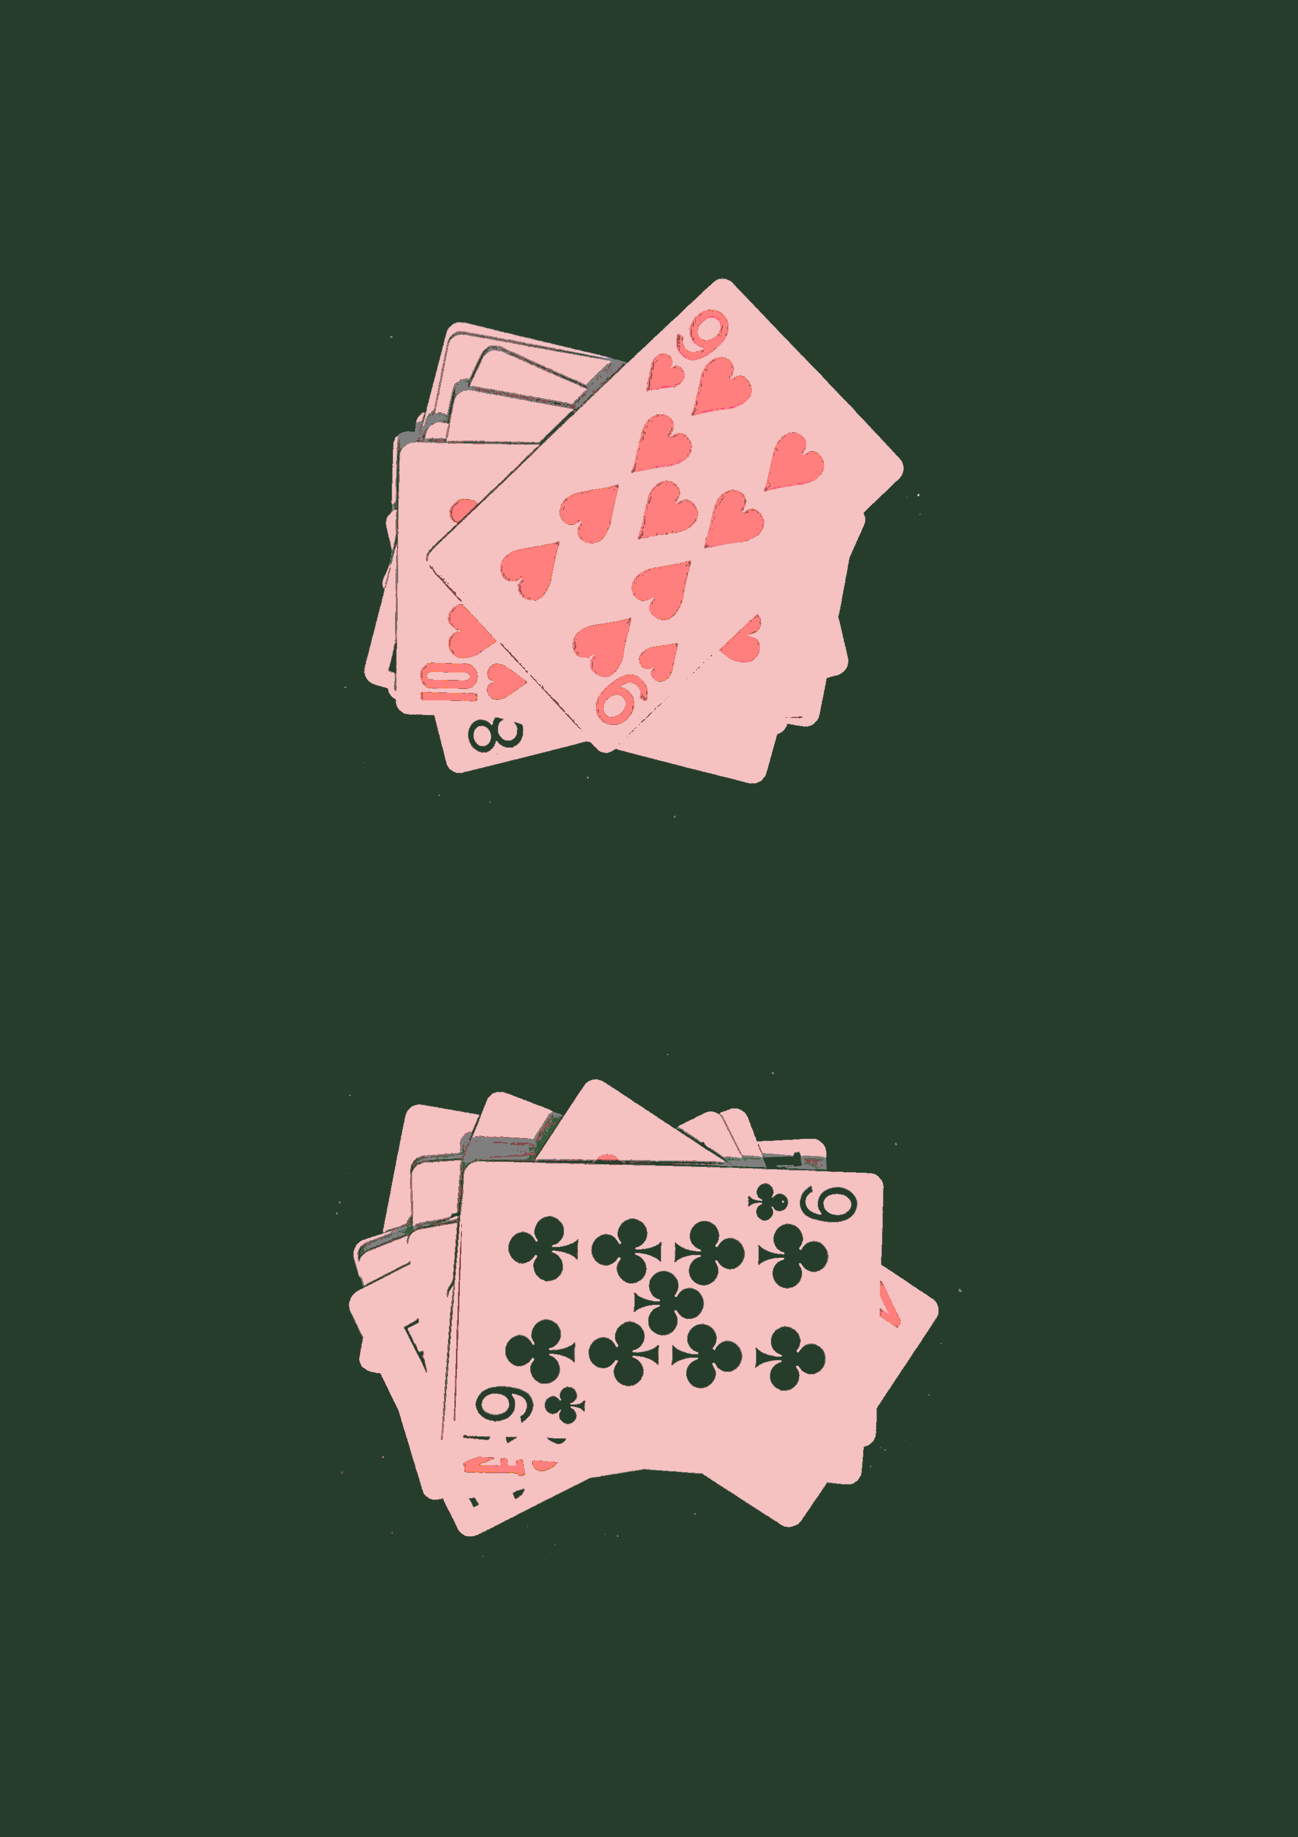
F.9 Illegal Slaps and Misslaps
F.9.1 A misslap occurs when a player attempts to slap when no slap condition is active.
F.9.2 A single accidental or reflex misslap carries no automatic penalty unless the referee believes it to be deliberate or disruptive.
F.9.3 Repeated misslaps may result in disciplinary action under Law I.
F.9.4 Aggressive slapping, including deliberate striking of the opponent or clearly unsafe force, is judged at referee discretion.
F.9.5 Aggressive contact arising naturally from both players legitimately going for the same slap at the same time is not, by itself, grounds for automatic sanction.
F.9.6 Where aggressive or dangerous intent is clear, the referee may issue Yellow or Red Cards under Law I.
F.10 Referee Authority During Slaps
F.10.1 The referee has full authority to determine whether a slap was valid, who completed valid two-hand contact first, and whether any misslap or foul slap has occurred.
F.10.2 The referee’s decision overrides any agreement or claim made by the players.
F.10.3 Where available, the referee may use video review to assist in determining the outcome of a slap challenge.
F.10.4 The referee may, in exceptional circumstances where a slap cannot fairly be resolved, call for a new reveal under Law F.6.
F.11 Governing Principle
F.11.1 Slap challenges are a defining feature of SLAPS, rewarding quick reflexes, awareness, and decisive action.
F.11.2 The ability to play a card that creates a slap condition and immediately complete a two-handed slap is a deliberate and accepted advantage for the player who holds the right card, and is part of the intended balance of the game.
F.11.3 All rulings on slaps must be made in line with the competitive, reflex-driven nature of SLAPS and the overall spirit of the game.
Laws of the Game 2025-26
LAW F
Slap Challenges

Slide 23
Draw Deck Shortage
G.1 Overview
G.1.1 This Law defines all procedures relating to Draw Deck Shortages during a match of SLAPS.
G.1.2 A Draw Deck Shortage alters the structure of play and must be managed precisely to maintain fairness.
G.1.3 Draw Deck Shortage procedures apply only after a stoppage of play (see G.3).
G.1.4 All slap-related consequences during shortages follow Law F, and all game-end rules follow Law H.
G.2 Definition of a Draw Deck Shortage
G.2.1 A Draw Deck Shortage occurs the moment a player has zero cards remaining in their Draw Deck.
G.2.2 A Draw Deck Shortage can only occur when a player still has at least one live Foundation card (unless the player has lost slap penalties in the same game - see G.9).
G.2.3 A shortage does not stop play immediately; play continues until the next natural stoppage (see G.4).
G.2.4 A shortage may also occur before a game begins if a player has ten or fewer cards available after shuffling.
G.3 Activation of Shortage Procedures
G.3.1 Shortage procedures take effect only once a stoppage in play occurs, including:
G.3.1.1 a stalemate;
G.3.1.2 a referee stoppage under Law E;
G.3.1.3 the end of the current game;
G.3.1.4 any situation requiring a new Draw Deck reveal.
G.3.2 When a stoppage occurs, and one player has no Draw Deck, the opponent’s Draw Deck must be split equally.
Law
G
Laws of the Game 2025-26
LAW G
Draw Deck Shortage

Slide 24
G.3.3 The top half of the opponent’s Draw Deck is placed where the shorted player’s Draw Deck would normally be.
G.3.4 The bottom card of the borrowed Draw Deck is turned sideways to indicate that these cards do not belong to the borrowing player but remain legally playable.
G.3.5 Borrowed Draw Decks must remain clearly separated in identity but function normally for all gameplay purposes.
G.4 Continuation of Play After a Shortage
G.4.1 After the Draw Deck has been split, play continues normally.
G.4.2 All rules governing card sequencing, slaps (Law F), and card play (Law D) remain fully applicable.
G.4.3 The player using the split Draw Deck may legally reveal cards from it as if it were their own.
G.4.4 The split Draw Deck is considered a temporary resource until the end of the game.
G.5 Outcomes After a Shortage
Outcome A — The shorted player wins the game
G.5.1 A shorted player who clears their Foundation Pile first wins the match, subject to G.5.2.
G.5.2 If that player has outstanding slap penalty cards from the current game, they must construct a new Foundation Pile using those cards and continue play until all cards under their control (including borrowed cards) have been eliminated.
Outcome B — The other player wins the game
G.5.4 If the player with the Draw Deck wins the game, they take:
G.5.4.1 their own half-Deck,
G.5.4.2 the borrowed half-Deck,
G.5.4.3 any slap penalties owed to them.
G.5.5 The losing player retains:
G.5.5.1 their remaining Foundation cards, and
G.5.5.2 any slap holding piles they received during the game, and
G.5.5.3 the cards in the centre pile.
G.6 Shortage Before a Game Starts
G.6.1 If a player has ten or fewer total cards after shuffling for a new game, a Draw Deck Shortage occurs immediately.
G.6.2 The opponent’s Draw Deck must be split at the start of the game using the same top-half procedure described in G.3.
G.6.3 The player with fewer than ten cards must construct a Foundation Pile using all available cards (maximum four live at any time).
G.6.4 A normal game then begins with a simultaneous Draw Deck reveal.
G.7 Multiple Shortages Within a Single Match
G.7.1 Multiple shortages can occur in a single game or match.
G.7.2 In principle, the Draw Decks should remain equal at all times after splitting; therefore, shortages for both players tend to occur simultaneously.
G.7.3 If a player reaches zero cards first, and the opponent still has cards, the top-half split procedure applies again.
G.7.4 If both players reach zero cards simultaneously during a game:
G.7.4.1 All Centre Pile cards are shuffled together;
G.7.4.2 The combined pile is split equally into two new Draw Decks;
G.7.4.3 Neither new Draw Deck belongs to either player;
G.7.4.4 A new reveal is performed;
G.7.4.5 Whoever clears their Foundation Pile first wins the match, subject to slap penalties.
G.7.5 This simultaneous-zero rule applies regardless of whether a previous split has occurred.
G.8 Odd-Numbered Draw Decks
G.8.1 If the opponent’s Draw Deck has an odd number of cards at the moment it must be split, one half will naturally have one more card than the other.
G.8.2 This irregularity is unavoidable and accepted as a natural part of the game.
Laws of the Game 2025-26
LAW G
Draw Deck Shortage

Slide 25
G.8.3 Players may reveal a single remaining Draw Deck card alone if necessary.
G.8.4 In simultaneous-zero situations, if one new Draw Deck has one extra card, this does not affect match outcomes.
G.8.5 The player who clears their Foundation Pile first still wins the match subject to H.4
G.9 Slap Penalties During Shortages
G.9.1 Slap penalties operate normally during shortages.
G.9.2 If a player loses a slap challenge during a shortage, they must still take all Centre Pile cards into their temporary holding pile.
G.9.3 If a player has no Draw Deck and no Foundation Pile left, but still has slap penalty cards outstanding, they must continue the match until those cards are removed.
G.9.4 A player may only win the match once they have eliminated:
G.9.4.1 their Foundation cards,
G.9.4.2 all Draw Deck cards under their control, and
G.9.4.3 any slap penalty cards.
G.10 Special Scenarios
G.10.1 If a shortage occurs but no stalemate is possible i.e., one player always has a legal move, play continues indefinitely until a natural stoppage occurs.
G.10.2 The referee may only call a stalemate if neither player can legally play; they may not call one simply to induce a split.
G.10.3 If a shortage occurs during a slap challenge, the slap proceeds normally.
G.10.4 Mis-reveals during shortages follow referee discretion under Laws D and F.
G.11 Ownership of Cards
G.11.1 Cards used as a borrowed Draw Deck remain the property of the original player.
G.11.2 Borrowed cards may be freely revealed and played but must be returned to their owner when the game ends unless G.5.4 applies.
G.11.3 If the player who borrowed cards wins the game, they have cleared all cards under their control and therefore win the match subject to G.9.
G.11.4 If the player who borrowed cards loses the game, the borrowed cards are returned to the original owner immediately.
G.11.5 The rulebook may recognise “temporary-use cards” as Draw Decks loaned during shortages.
G.12 Governing Principle
G.12.1 Draw Deck Shortage rules exist to preserve continuity of play when a player’s deck is exhausted, and to ensure that both players have equal access to draw-based reveals.
G.12.2 The halving mechanism does not provide an advantage or disadvantage to either player, as both players will face the same conditions if they intend to win the match.
G.12.3 All Draw Deck Shortage rulings must be applied consistently by the referee and understood as natural consequences of how SLAPS functions.
Laws of the Game 2025-26
LAW F
Slap Challenges

Slide 26
End of Game and End of Match
H.1 Overview
H.1.1 This Law defines the conditions under which a game ends and the conditions required to win an entire match.
H.1.2 All card mechanics are governed by Law D, slap rules by Law F, and Draw Deck Shortages by Law G.
H.1.3 For match concessions, suspensions, and restarts, Law E also applies.
H.2 End of a Game
H.2.1 A game ends the moment a player successfully plays their final Foundation card onto a Centre Pile.
H.2.2 The final card must be played in accordance with Law D.
H.2.3 If the final card lands at an imperfect angle or position, the game is still complete provided that the opponent cannot legally play onto it.
H.2.4 If the final card’s placement is unclear and the opponent still had a legal play available; the referee must instruct the winning player to correct the placement without benefiting from the delay.
H.2.5 Any slap condition resulting from the final Foundation card is automatically void.
H.2.6 No slap challenge may occur after the final Foundation card is played, regardless of player reaction or timing.
H.3 Game Outcome
H.3.1 The player who clears their Foundation Pile first wins the game.
H.3.2 Remaining Draw Deck cards are irrelevant to determining the game winner.
H.3.3 Slap penalty cards are also irrelevant to determining the game winner; they affect match progression only.
Law
H
Laws of the Game 2025-26
LAW H
End of Game and End of Match

Slide 27
H.4 End of Match
H.4.1 A player wins the match when they have eliminated all cards under their control, defined as:
H.4.1.1 all Foundation Pile cards;
H.4.1.2 all Draw Deck cards including borrowed cards during shortages;
H.4.1.3 any slap penalty cards accumulated during the match.
H.4.2 The player must remove all cards through legal gameplay across one or more games.
H.5 Concessions
H.5.1 A player may concede the match at any time.
H.5.2 If a concession occurs during a game, the opponent is awarded one additional game win.
H.5.3 If a concession occurs between games, no additional game is awarded.
H.5.4 A concession immediately ends the match and all further gameplay.
H.6 Special Situations
H.6.1 If both players appear to finish their Foundation Pile at the same time, the winner is the player who legally released their final Foundation card first.
H.6.2 If the referee cannot determine who played the final card first, the game is declared “too close to call.”
H.6.3 In such a case, all cards involved in the final sequence are returned to their owners and a new simultaneous Draw Deck reveal is performed to restart the game.
H.6.4 This restart does not affect the overall match score except to replay the unresolved game.
H.7 Post-Game Procedures
H.7.1 When a game ends, both players must gather and keep separate the cards under their control.
H.7.2 Any slap penalty cards assigned to a player become part of their deck for the next game.
H.7.3 Before the next game begins, each player must:
H.7.3.1 shuffle all cards under their control thoroughly;
H.7.3.2 construct a new Foundation Pile using the top ten cards or all available cards if fewer than ten;
H.7.3.3 form a new Draw Deck from the remaining cards.
H.7.4 The referee must confirm readiness before the next game begins, though players may also confirm readiness themselves.
H.8 Governing Principle
H.8.1 The end-of-game and end-of-match structure ensures that match victory reflects complete elimination of all cards under a player’s control.
H.8.2 Any ambiguity about timing, card placement, or game completion must be resolved in line with fairness, competitive integrity, and the fast-paced nature of SLAPS.
Laws of the Game 2025-26
LAW H
End of Game and End of Match

Slide 28
Competition Format
and Elo
I.1 Overview
I.1.1 This Law defines the structures, ranking rules, and organisational requirements for competitive SLAPS.
I.1.2 Competition formats, league systems, Elo rankings and knockout procedures are governed by this Law unless superseded by specific tournament regulations.
I.1.3 All competitive matches must be played in full accordance with the Laws of the Game.
I.2 Recognised Competition Formats
I.2.1 The following match formats are recognised:
I.2.1.1 League competitions;
I.2.1.2 Knockout tournaments;
I.2.1.3 Friendly matches;
I.2.1.4 Exhibition matches;
I.2.1.5 Finals and championship rounds;
I.2.1.6 Group-stage competitions.
I.2.2 Competition organisers may define specific structures for these formats, provided they do not contradict the Laws of SLAPS.
I.2.3 Match rules and scoring remain identical across all formats unless explicitly modified by tournament regulations.
I.3 League Format
I.3.1 A win in a league match awards 1 league point.
I.3.2 A loss awards 0 league points.
I.3.3 Draws are impossible in SLAPS.
I.3.4 League tables are ordered by descending points.
Law
I
Laws of the Game 2025-26
LAW I
Competition Format and Elo

Slide 29
I.3.5 If two or more players are level on points, positions are determined by a tiebreaker:
I.3.5.1 Net Games Won − Lost + Net Slaps Won − Lost
I.3.6 This formula must be applied in all league competitions.
I.3.7 If players remain tied after applying I.3.5, the result of the match between those players determines who finishes higher.
I.3.8 In the highly unlikely event that head-to-head outcomes and net totals are also identical, the match between those players must be replayed as a full match.
I.3.9 This replayed match counts only for tiebreak purposes and does not affect Elo unless a referee is present.
I.4 Knockout Format
I.4.1 In knockout competitions, the winner of the match advances.
I.4.2 Total games won or slaps won do not influence progression.
I.4.3 All game and slap results in knockout matches must still be logged, even though they do not influence progression.
I.4.4 In a knockout stage requiring a preliminary round e.g., non-power-of-two number of players, byes must be allocated to the highest-ranked players by Elo.
I.4.5 The lowest-ranked players must compete in preliminary fixtures until the bracket conforms to a standard knockout structure 2, 4, 8, 16, 32 players, etc.
I.4.6 This principle applies universally unless tournament regulations specify otherwise.
I.5 Elo Rating System
I.5.1 Elo updates may only occur in matches where a referee is present.
I.5.2 Elo is not updated for:
I.5.2.1 training matches;
I.5.2.2 unsupervised matches;
I.5.2.3 friendlies without prior mutual Elo agreement.
I.5.3 In friendlies with a referee present, Elo may only be updated if both players explicitly agree before the match begins.
I.5.4 In any official competitive match with a referee present, Elo must be updated.
I.5.5 All Elo updates are based solely on match result (win/loss).
I.5.6 Games won, games lost, slap differentials or performance margins do not influence Elo.
I.5.7 Elo adjustments and calculation methodology are administered independently by the International Slaps Federation and are not disclosed in the Laws.
I.5.8 All new players begin with an Elo rating of 1000.
I.5.9 No minimum or maximum Elo change is specified in the Laws; this is determined operationally by the International Slaps Federation.
I.6 Match Administration
I.6.1 Match results must record:
player 1’s name
player 2’s name
games won by each player;
slaps won by each player;
cards shown to each player;
referee name
match winner.
I.6.2 Elo updates are applied only after results are verified by the referee.
I.6.3 Disciplinary actions do not carry beyond a match (see Law I).
I.6.4 Competition organisers may introduce additional rules on:
venue standards;
scheduling;
administrative procedures;
entry or participation criteria;
provided no such regulations conflict with the Laws of SLAPS.
Laws of the Game 2025-26
LAW I
Competition Format and Elo

Slide 30
I.7 Time, Venue, and Forfeiture Rules
I.7.1 SLAPS has no fixed time limit for match completion.
I.7.2 Competitions may impose a game cap e.g., first to 20 games if no match winner has emerged.
I.7.3 A forfeit occurs when a player fails to appear or cannot begin the match.
I.7.4 A forfeit results in a recorded 2–0 match win for the player who attends.
I.7.5 Forfeited matches do not affect Elo.
I.7.6 Slaps are recorded as 0–0 in forfeited matches.
I.8 Governing Competition Principles
I.8.1 All competitions must provide equal and fair conditions for both players.
I.8.2 Competition regulations must never contradict the SLAPS Laws of the Game.
I.8.3 Tournament organisers are encouraged to maintain consistency, fairness, and transparency in all competition-related decisions.
Laws of the Game 2025-26
LAW I
Competition Format and Elo

Slide 31
Founding Members
George Alexander
William Bruce
Daniel Lansell
Jack Litman
Daniel Newcombe
William Schelpe
Laws of the Game 2025-26
LAW I
Competition Format and Elo

